Slide 1
9 – Clean Code – Single Responsibility Principle (SRP)
Based on the CleanCoders videos by Uncle Bob Martin
Rupert Waldron

Slide 2
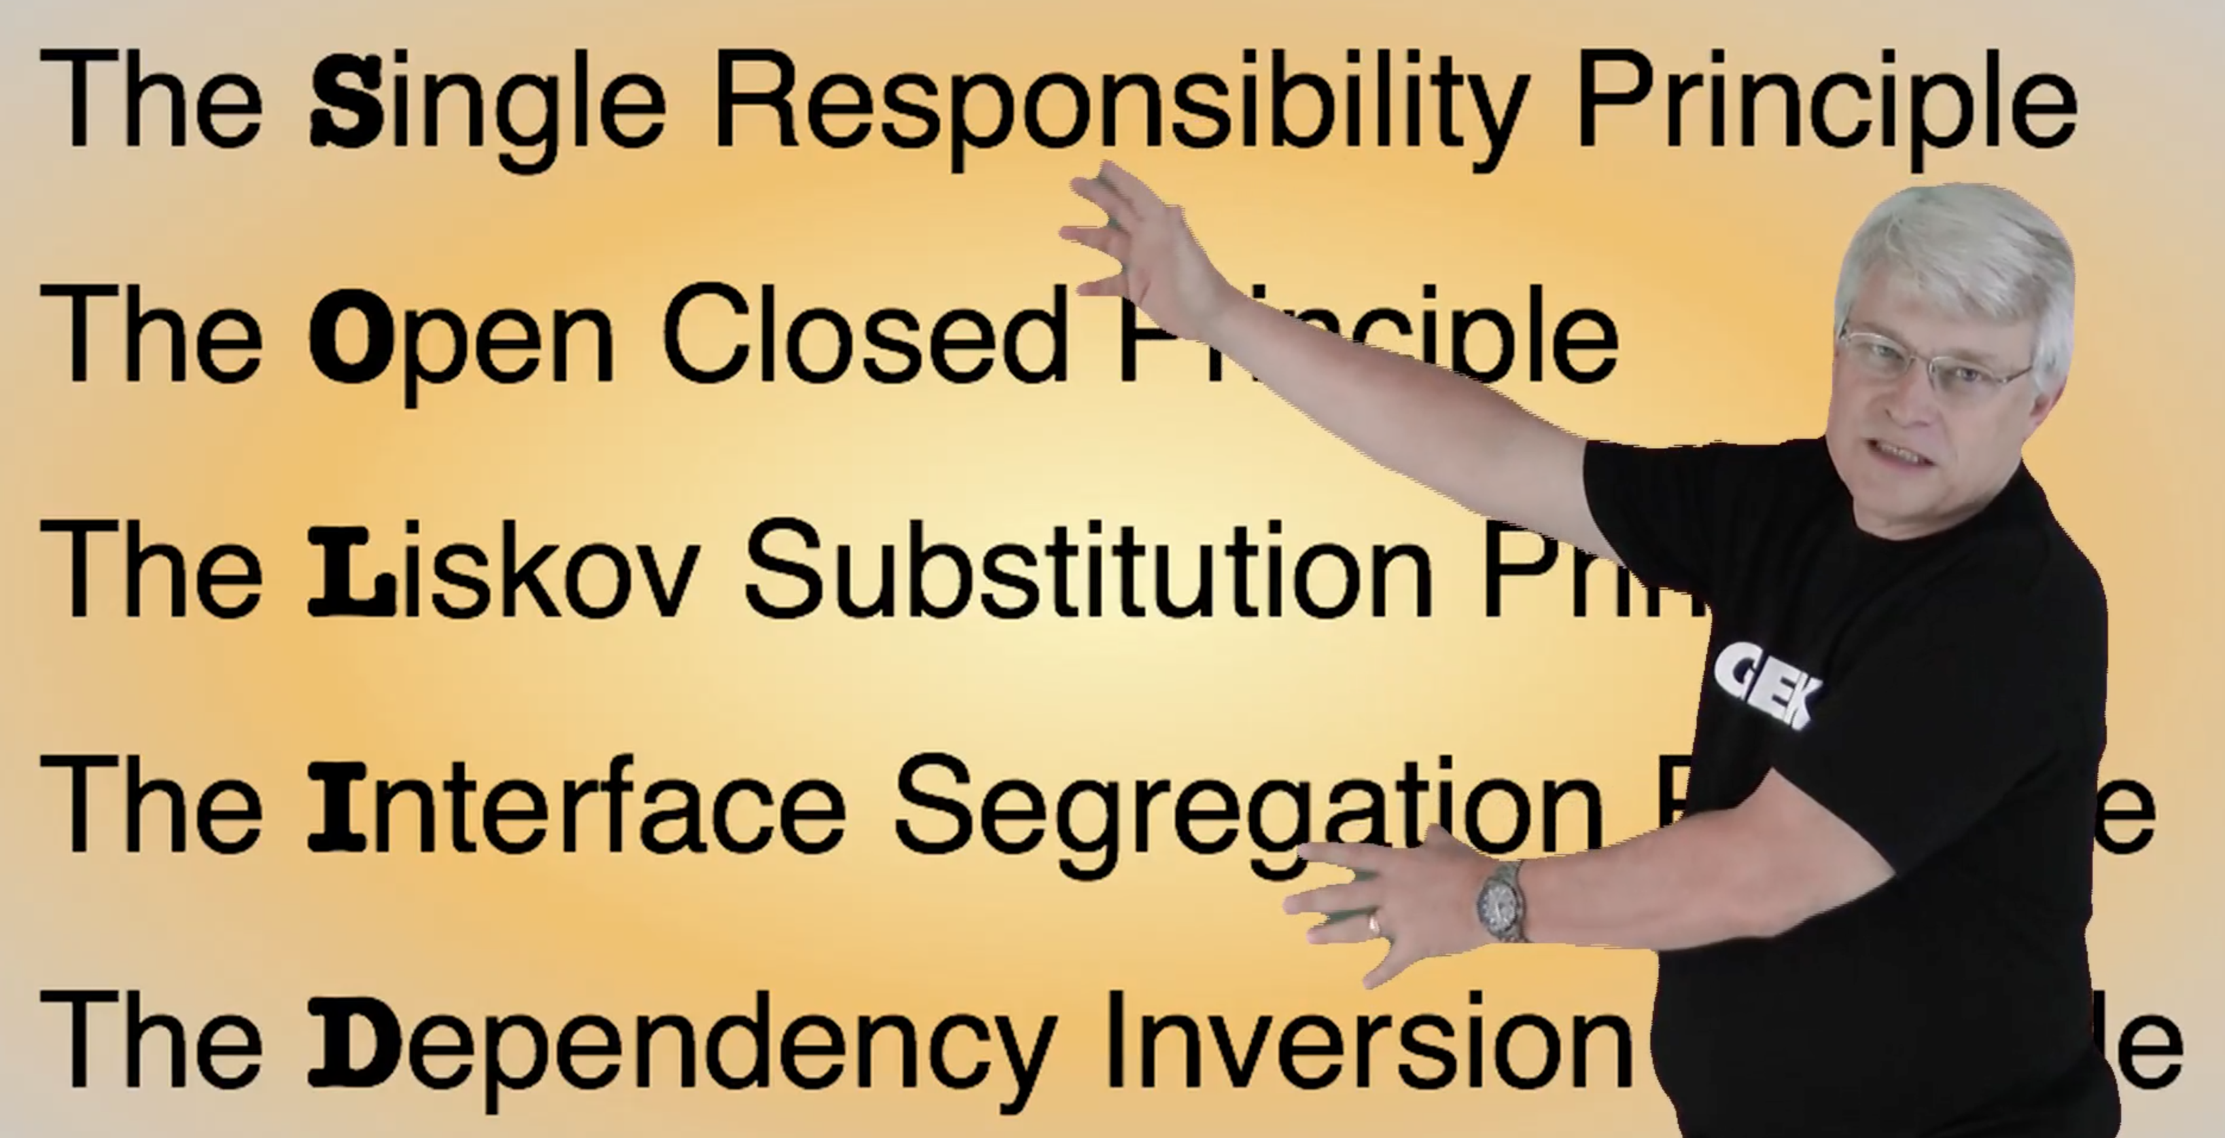
Object Orientated Design is all about Dependency Management
Uncle Bob gives us these dependency management principles that control operations and relationships between classes

Slide 3
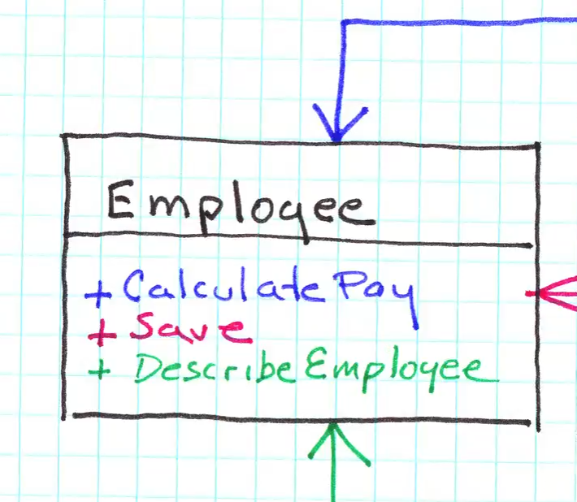
Single Responsibility Principle
The best modules have classes with just one responsibility. The SRP is referring to the responsibility the classes and functions have to its users – specifically those users that request changes to the software.
So what is one responsibility?
How many responsibilities does this class have?
How about if we add new methods:
- Find EmployeeById
- SummarizeHoursWorked
Now how many responsibilities does this class have?

Slide 4
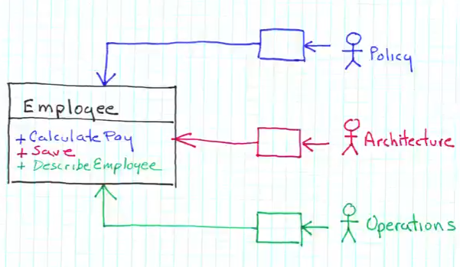
It’s all about the users
SRP is about users, the responsibility it talks about are the responsibly the classes and functions have to those users. It is typically users who will request changes to the software.
A responsibility can therefore be viewed as a source of change
It is more about roles than users. When users play roles we call them Actors.
These three users could request changes to the class depending on their needs
The 3 actors are: Policy, Architecture and Operations When ever the needs of an actor change, the functions that serve that actor will also need to change

Slide 5
A Responsibility is….
…. A family of functions that serves one particular actor.

Slide 6
The two values of software
Secondary Value of Software
Primary Value of Software
The secondary value of software is its behaviour – this is high if it does what the user needs without any bugs crashes or delays.
The primary value of software is the ease at which the software can be changed to meeting the user’s changing requirements
The profitability of the company is therefore tided to the primary value of software… hence it is primary
The secondary value occurs when the current software, meets the current needs of the current user.
The current user’s needs change and the secondary value of software begins to wane.
To keep the secondary value high the company must continually change the software to keep up with the user’s needs

Slide 7
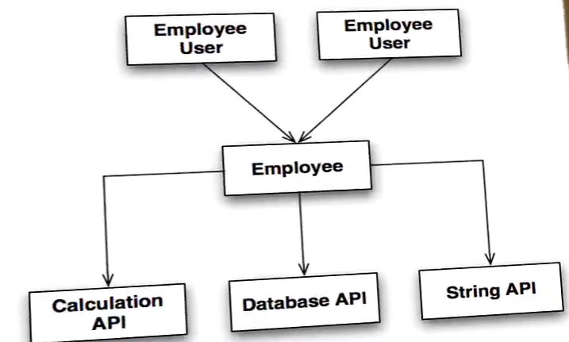
Co-location is coupling
Both Policy and Architecture need to make changes to meet new user requirements. Now they end up working in the same module -> merge conflicts. Changes are difficult – reducing the primary value of the software.
These classes depend upon the Employee class and also affected by all those dependences.
The employee class has so many responsibilities it has a huge fan out.
You can reduce the fan-out by reducing the responsibilities of the class
If a new report is added to Employee all the dB and Calculation APIs will need to be recompiled when it is deployed. The APIs are coupled together. The co-location of responsibilities couples the Actors.

Slide 8
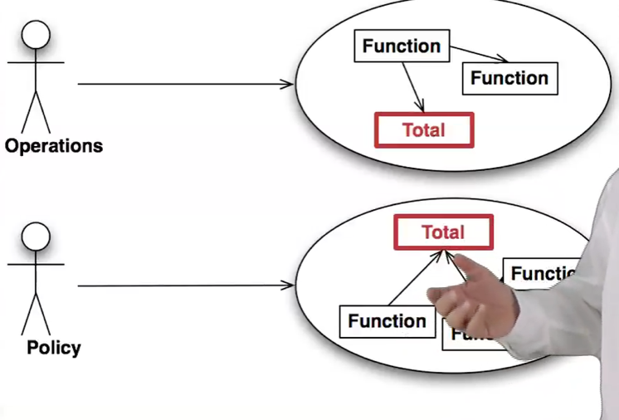
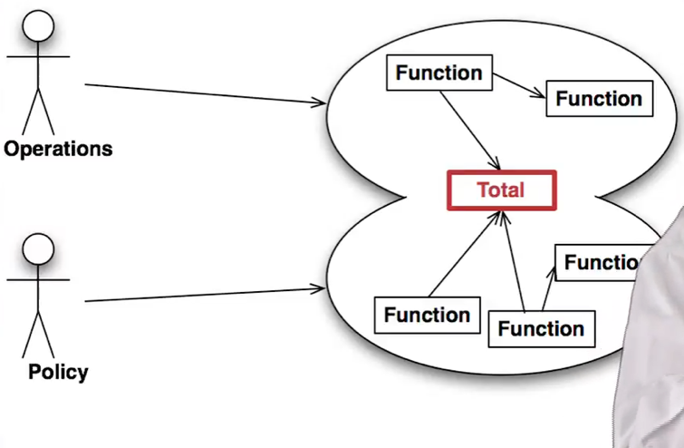
Sharing a functional class
This Total class does the same thing for both Operators and Policy Actors
Think of DRY (Do not repeat yourself!) and reuse the Total class.
Now the classes are coupled… soon Policy and Operations Actors requirements diverge and one change in Operations will break Policy – we end up with Fragility

Slide 9
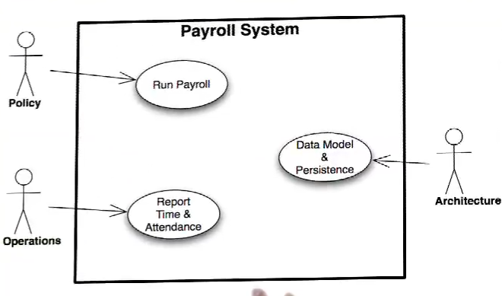
SRP
The SRP states that a module should have one… and only one reason to change. One and only one responsibility. Gather together things that change for the same reasons and separate things that change for different reasons.
First – define who the actors are

Slide 10
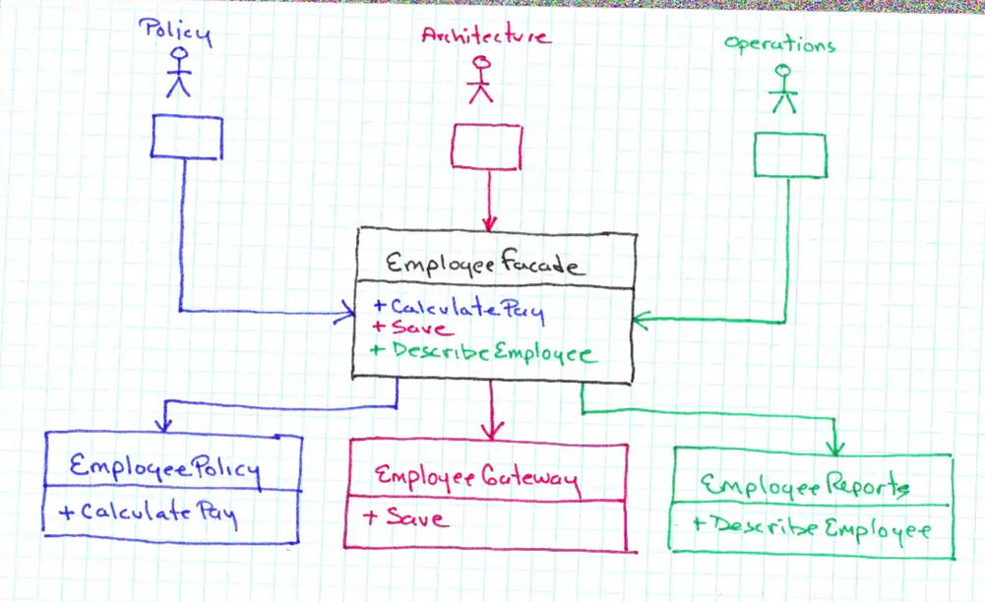
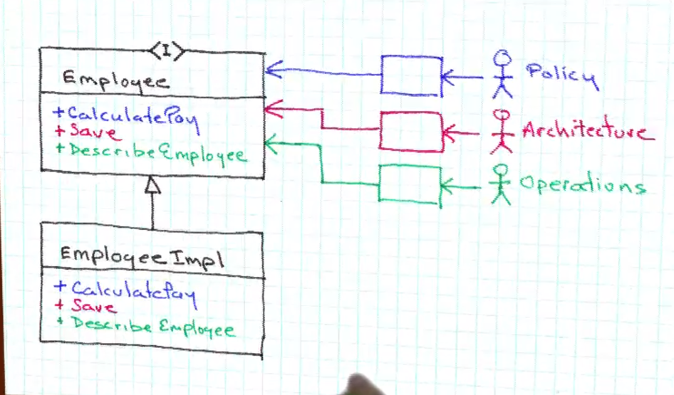
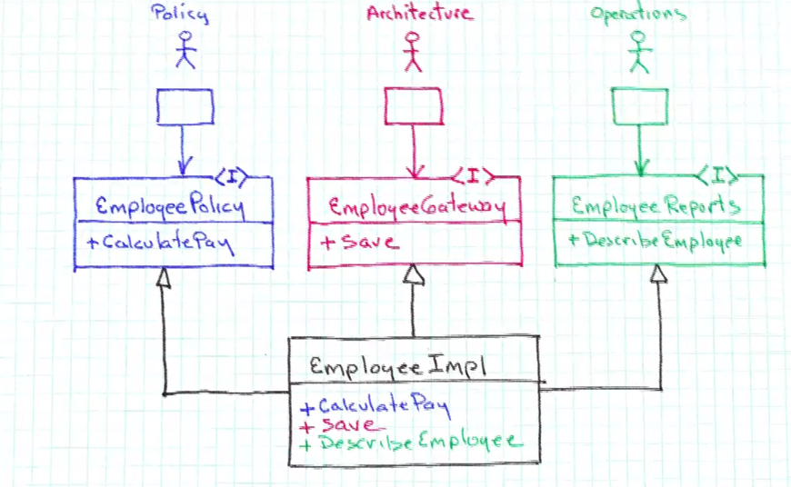
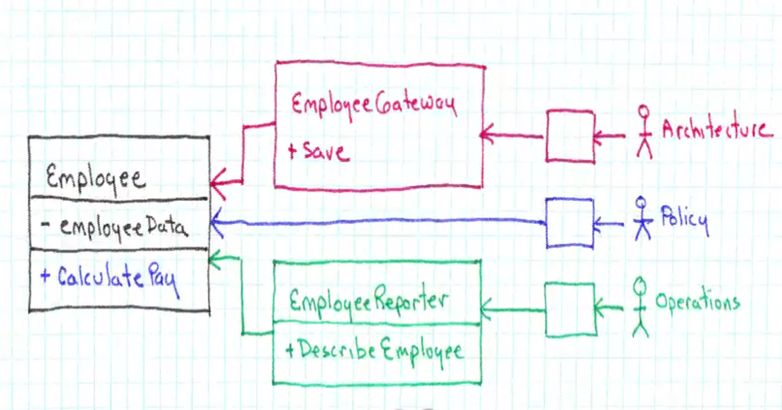
What are our options
Split into interface and implementation – tada!
Use the façade pattern – however Actors are still coupled together
Split into separate classes – transitive dependency between Reporter and Gateway via Employee. Also the entry point to employee is split around the system
Interface Segregation

Slide 11






Can be worked on as separate modules – only Employee is shared.
PolicyUI
ArchitectUI
OperationsUI
PayPolicy
Gateway
EmployeePrinter
WeeklyPayPolicy
TreeMapGateway
DefaultEmployPrinter
DefaultPayPolicy
HashMapGateway
Employ is now a data structure and knows nothing about the other classes – arrows only point one way.
Employee

